Slide 1
Cartoon Analysis
Presidential Power IDM Day 1 Integrated Social Studies

Slide 2
Cartoon Analysis
We will work on the first cartoon together as a class.
Follow along and make notes on your note sheet!
You will complete the second cartoon on your own.

Slide 3
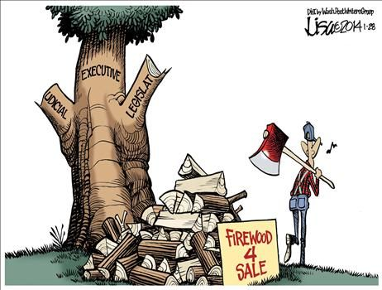
Cartoon Analysis

Slide 4
Cartoon Analysis – You’re Turn!
You have a different cartoon on your worksheet.
You will have ten minutes to complete this assignment.
We will switch papers and go over this as a class.

